Slide 1
Backend Development

Slide 2
Topics we will be covering
What is Backend Development
How frontend and backend interacts with each other
Different types of HTTP requests
Application programming interfaces (APIs)
How API works
2 examples of backend frameworks : Django & Nodejs

Slide 3
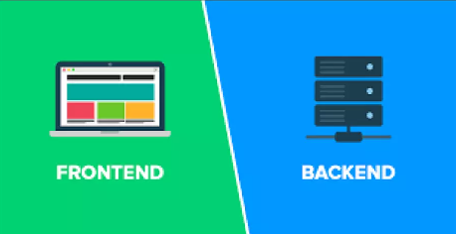
Components of a web application
Client Side
Server side

Slide 4
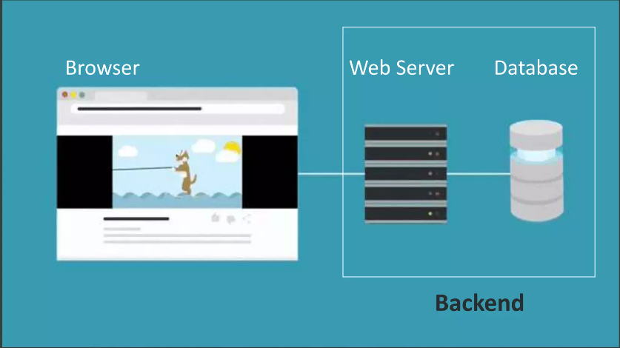

Slide 5
What is Backend Development?
Back-end development covers server-side web application logic and integration and activities, like writing APIs, creating libraries, and working with system components instead of frontend development, which focuses on customer-facing services and programs.
Backend developers build code that allows a database and application to communicate with one another.
Backend developers take care and maintain the back-end of a website, Including databases, servers, and apps, and they control what you don't see.

Slide 6
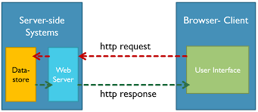
How frontend and backend interacts

Slide 7
How frontend and backend interacts
Frontend and backend communicate with each other via HTTP requests.
A client (browser) sends an HTTP request to the server; then the server returns a response to the client.
An HTTP request is made from a client to a host located on the server in order to receive a resource needed to build the content.
An HTTP response is made by a server to a client. The aim of the response is to provide the client with the resource it requested, or inform the client that the action it requested has been carried out; or else to inform the client that an error occurred in processing its request.

Slide 8
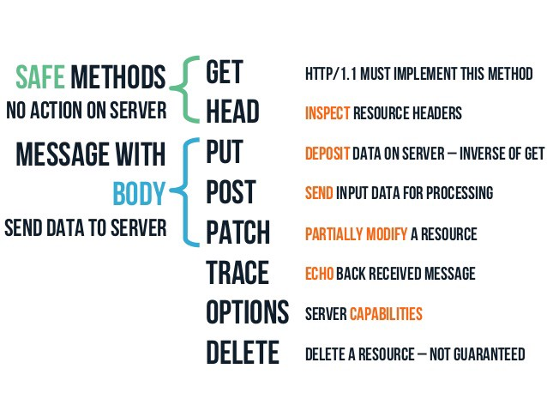
Types of HTTP requests

Slide 9
GET request
A GET request retrieves data from a web server by specifying parameters in the URL portion of the request
This is the main method used for document retrieval.
Get request is not secured because data is exposed in URL bar.
In case of Get request, only limited amount of data can be sent because data is sent in header/URL.
GET requests should never be used when dealing with sensitive data.

Slide 10
POST request
The POST method is used to send data to the server, for example: login info.
The data sent to the server with POST is stored in the request body of the HTTP request.
In case of post request, large amount of data can be sent because data is sent in body.
Post request is secured because data is not exposed in URL bar.
Used to send sensitive data (emails, password, etc) to server.

Slide 11
HTTP response codes
An HTTP response is made by a server to a client. The aim of the response is to provide the client with the resource it requested, or inform the client that the action it requested has been carried out; or else to inform the client that an error occurred in processing its request

Slide 12
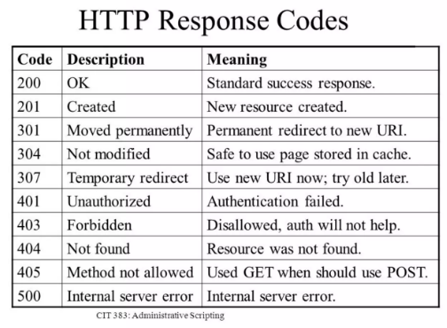

Slide 13
Application Programming Interface (API)
APIs are mechanisms that enable two software components to communicate with each other using a set of definitions and protocols.
For example, the weather bureau’s software system contains daily weather data. The weather app on your phone “talks” to this system via APIs and shows you daily weather updates on your phone.
Interface can be thought of as a contract of service between two applications. This contract defines how the two communicate with each other using requests and responses.

Slide 14
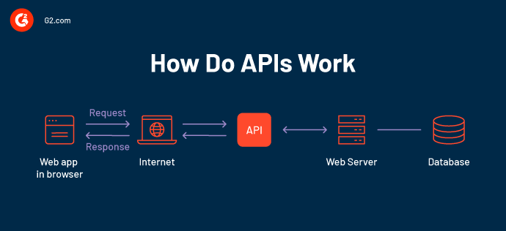
How APIs Work

Slide 15
How API works
A client application initiates an API call to retrieve information—also known as a request. This request is processed from an application to the web server via the API’s Uniform Resource Identifier (URI) and includes a request verb, headers, and sometimes, a request body.
After receiving a valid request, the API makes a call to the external program or web server.
The server sends a response to the API with the requested information.
The API transfers the data to the initial requesting application.

Slide 16
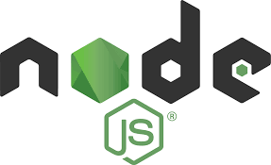



Popular Backend frameworks

Slide 17
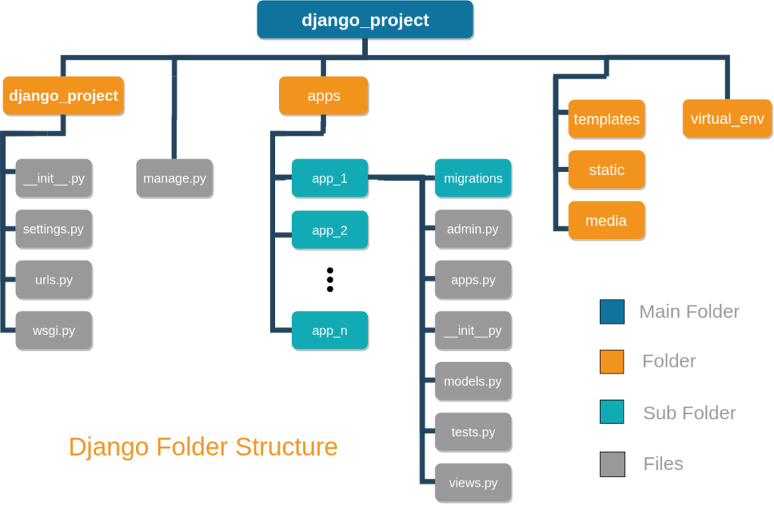
Introduction to Django
The web framework for perfectionists with deadlines.
Python web framework
free and open source
designed to help developers take applications from concept to completion as quickly as possible
MVT architecture (models, views, templates)

Slide 18
Roadmap for Django
Python
Virtual Environments (including managing different python versions)
Django
Django Rest Framework

Slide 19
Free Resources for learning Django
freecodecamp: Django For Everybody
Beginners course: Python Django Tutorial: Full-Featured Web App
Django Documentation: https://docs.djangoproject.com/en/4.0/intro/overview/
Django REST Framework: Build an API with Django
DRF Documentation: https://www.django-rest-framework.org/
DRF Book: DRF.pdf

Slide 20
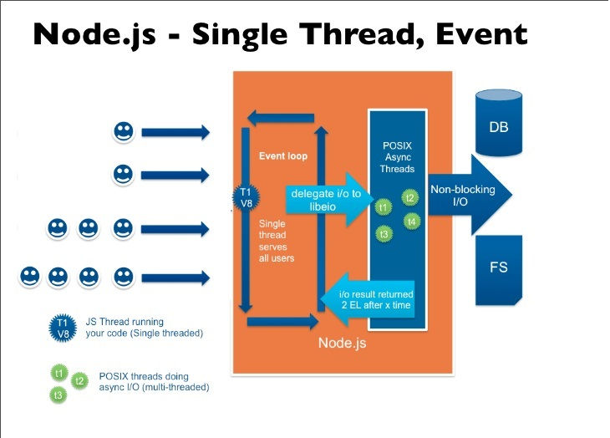
Introduction to NodeJS
Use JavaScript on both the front-end and back-end with Node.js for fast and efficient full-stack development
Node.js is an open-source, cross-platform JavaScript runtime environment.
Node.js uses a non-blocking, event-driven I/O model, making it suitable for building real-time, data-intensive applications.
Node.js has a large and active community, which has created a vast ecosystem of libraries and modules (npm) for various purposes.

Slide 21
Roadmap for NodeJS
Learn the basics of JavaScript
Learn the basics of Node.js: Learn about the core concepts of Node.js, including modules, events, and the event loop
Learn about Express: Express is a popular framework for building web applications with Node.js
Learn MongoDB which is a noSQL database
Learn about Socket.io: Socket.io is a popular library for real-time communication between client and server
Put all of your knowledge to the test by building a complete application using Node.js, Express, and MongoDB

Slide 22
Free Sources for learning NodeJS
NodeJS website : provides documentation and tutorials on how to get started with Node.js
MDN Web Docs : offers a comprehensive tutorial on how to build web applications with Node.js and Express
FreeCodeCamp : offers a free, self-paced curriculum that covers the basics of Node.js and related technologies
NodeJS Youtube Channel : provides a wealth of video tutorials, webinars, and other educational resources
Books: "Node.js in Action" by Mike Cantelon, Marc Harter, T.J. Holowaychuk, and Nathan Rajlich, "Learning Node.js Development" by Andrew Mead

